Slide 1
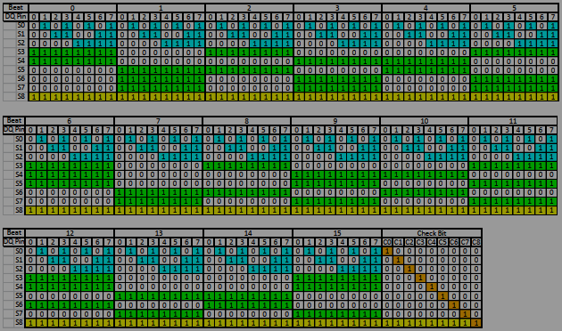
LPDDR5/6 Link ECC
Chen-Hsiung Liu
2024/3/10

Slide 2
Agenda
Hamming Distance and basic ECC
Single Error Correction (SEC) Code
(7, 4) Hamming Code
Single Error Correction, Double Error Detection (SECDED) Code
(8, 4) Hamming Code
LPDDR5 Link ECC code H-matrix
LPDDR6 Link ECC code H-matrix

Slide 3
Terminology
Single Error Correction, Double Error Detection (SECDED)
Hamming Distance
(7, 4) Hamming Code
Codeword
Dataword
Syndrome
H-matrix

Slide 4
Hamming Distance
The number of positions at which the corresponding symbols are different.
1011101 and 1001001 hamming distance is 2
110
111
010
011
100
101
000
001

Slide 5
Hamming Distance for ECC
Single Error Detection (SED)
Codeword Hamming Distance needs 2
e.g. even parity or odd parity
110
111
010
011
100
101
000
001

Slide 6
Hamming Distance for ECC
Single Error Correction (SEC)
Codeword Hamming Distance needs 3
110
111
010
011
100
101
000
001

Slide 7
Geometric concept for finding d_{min}
d_{min} is Minimum Hamming Distance
Correct t errors, d_{min} > 2t
d_{min}
2 | single error detection (SED)
3 | single error correction (SEC)
4 | single error correction + double error detection (SECDED)
x
Radius t
Radius t
y
d_{min} > 2t

Slide 8




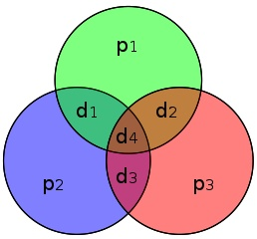
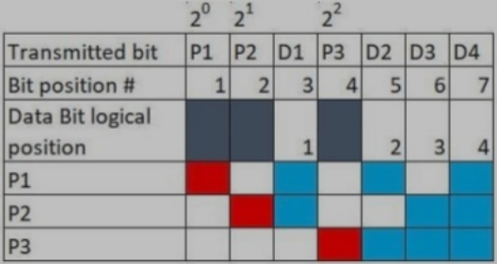
(7, 4) Hamming Code
P1 = D1 ^ D2 ^ D4 P2 = D1 ^ D3 ^ D4 P3 = D2 ^ D3 ^ D4
The matrix is called a generator matrix of a linear (n,k) code, and is called a parity-check matrix or H-matrix.

Slide 9
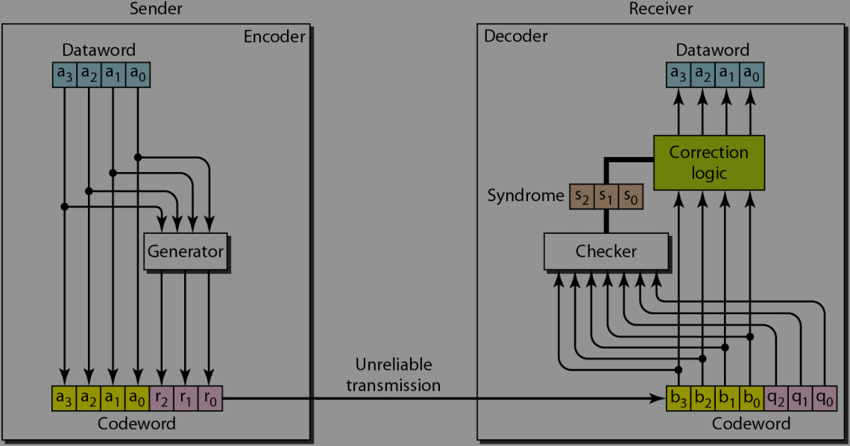
Hamming(7,4) Hardware architecture

Slide 10
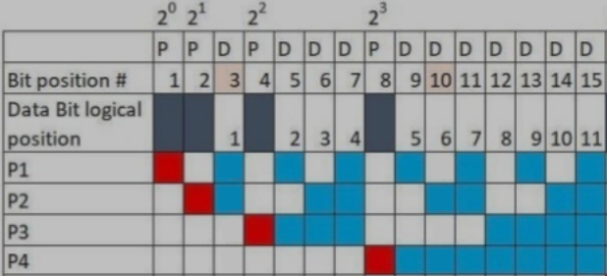
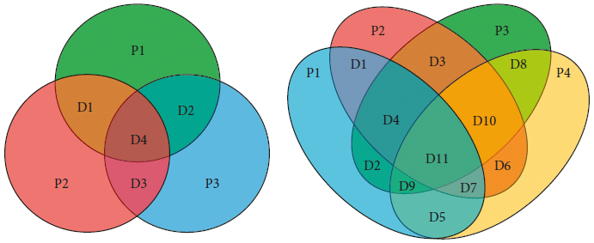
Hamming Code and Venn Diagram
Hamming (7,4) and Hamming (15,11)

Slide 11
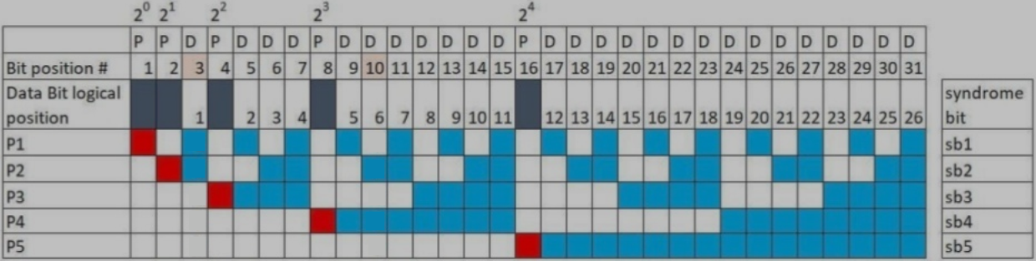
Hamming Code Algorithm
The general algorism generate a Single Error Correction (SEC) Code
Number the bits starting from 1: bit 1, 2, 3, 4, 5, 6, 7, etc.
Write the bit numbers in binary: 1, 10, 11, 100, 101, 110, 111, etc.
All bit positions that are powers of two (have a single 1 bit in the binary form of their position) are parity bits: 1, 2, 4, 8, etc. (1, 10, 100, 1000)
All other bit positions, with two or more 1 bits in the binary form of their position, are data bits.
Each data bit is included in a unique set of 2 or more parity bits, as determined by the binary form of its bit position.

Slide 12
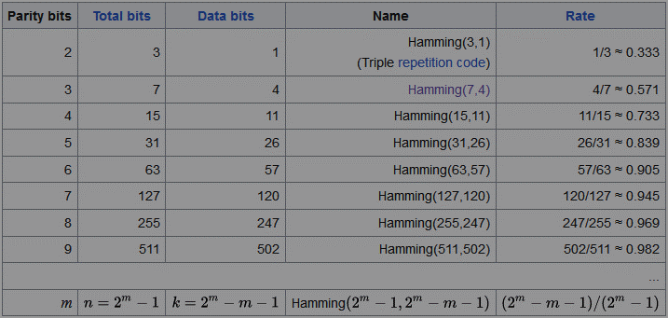
Code Rate of Hamming Code
Possible SEC Hamming Codes

Slide 13


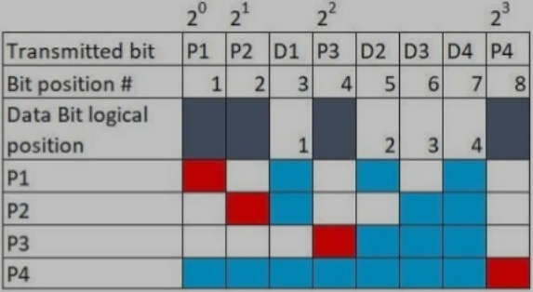
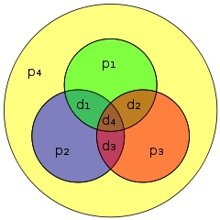
(8, 4) Hamming Code
(7,4) Hamming code with extra parity bit
P4 = D1 ^ D2 ^ D3 ^ D4 ^ P1 ^ P2 ^ P3
Single Error Correction Double Error Detection (SECDED)

Slide 14
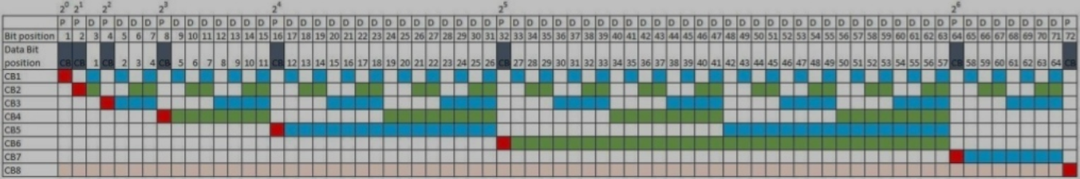
Hamming(72,64) SECDED Code
A truncated form of (127,120) code with extra parity bit
Frequently-used SECDEC Hamming Code
Hamming(39,32) is 32-bits data + 7-bits parity
Hamming(72,64) is 64-bits data + 8-bits parity

Slide 15
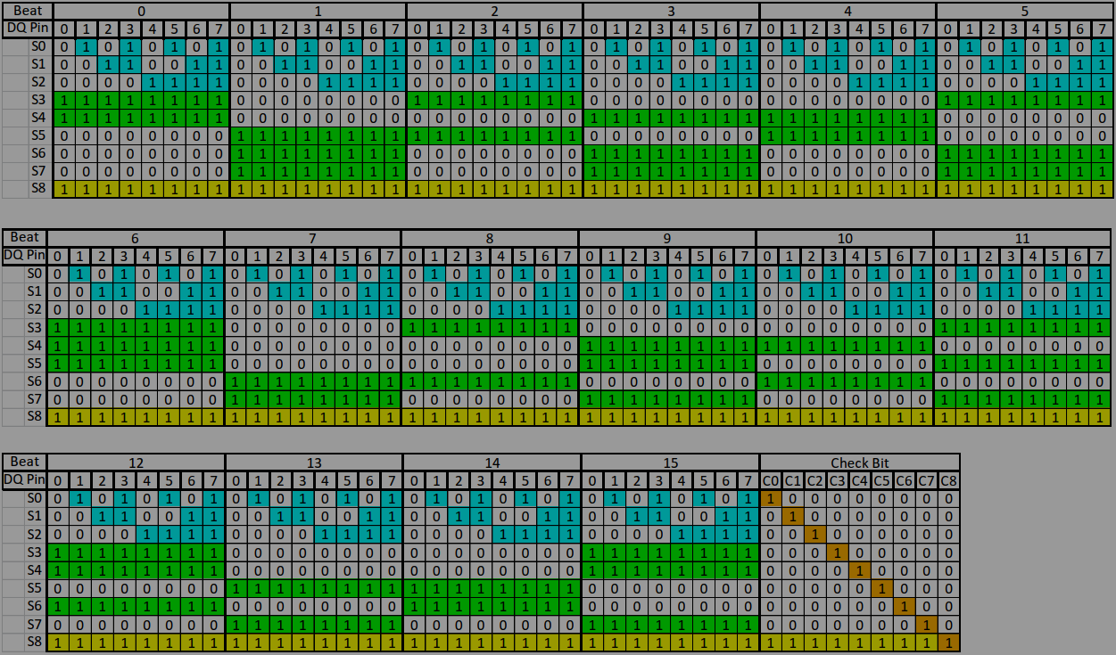
LPDDR5 Link ECC code H-matrix
Notes:
DV prefer code type 2.
Reason 1: It usable for coverage collection.
Reason 2: It easier to be traced by Verdi.

Slide 16
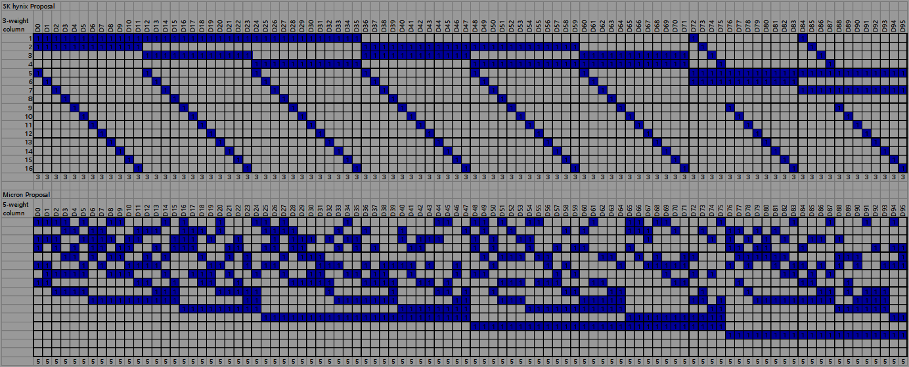
LPDDR6 Link ECC code H-matrix
Comparison with Current Proposal
SK Hynix 3-column vs. Micron 5-column Hsiao code
Notes:
DV prefer code type 2.
Reason 1: It usable for coverage collection.
Reason 2: It easier to be traced by Verdi.

Slide 17
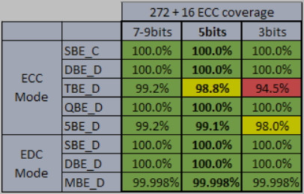
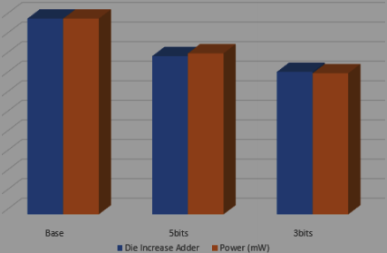
LPDDR6 Link ECC code H-matrix
5-col H-matrix chosen for error diagnostics relative to implementation

Slide 18
Reference
https://en.wikipedia.org/wiki/Hamming_code
https://mauc.edu.iq/wp-content/uploads/%D9%85%D8%AD%D8%A7%D8%B6%D8%B1%D8%A7%D8%AA%20%D9%87%D9%86%D8%AF%D8%B3%D8%A9%20%D8%A7%D9%84%D8%AD%D8%A7%D8%B3%D9%88%D8%A8/comp.net/comp.net11.pdf
https://www.slideshare.net/SkCheah/memory-ecc-the-comprehensive-of-secded
https://yiweimao.github.io/blog/hamming/
[slide] TG426_9 20240131 xxxx.xx SK hynix LPDDR6 Link ECC EDC H-matrix Proposal
[slide] JC426_9 20240228 1889.01 Micron LPDDR6_Selectable_LINK_ECC_EDC_272_ECC_DC_TG_Showing

